Slide 1
CSCE 5520
Wireless Networks and Protocols Localization
1
Page 1

Slide 2
Outline
Properties of localization procedures
Approaches
» Proximity
» Trilateration and triangulation (GPS)
» Finger printing (RADAR)
» Hybrid systems
2
Page 2

Slide 3
Properties of localization procedures
Physical position vs data types
Reference systems
Processing: localized vs centralized
Data quality
» Accuracy and precision
» Scale
Deployment aspects
» Limitations
» Cost
→ Very diverse systems – lots of research
3
Page 3

Slide 4
Data types
Point locations in terms of coordinates:
» physical or geometric locations
» GPS: latitude and longitude, height
» Cartesian coordinate system based on three orthogonal planes
Extended region locations given by names:
» symbolic locations
» CMU, Wean Hall, room 8202
4
Page 4

Slide 5
Location-awareness
Location model: data structure that organizes locations
Location-based routing
» symbolic location model
» geometric location model
» hybrid location model
Examples
» symbolic location model: address hierarchy DH.Floor2.2105
» geometric location model: GPS coordinate (12.3456°N, 123.456°E)
» hybrid location model: combination of address and coordinate DH.Floor2.2105.Seat(0,4)
5
Page 5

Slide 6
Quality of Position Information
Positioning accuracy:
largest distance between an estimated position and the true position
Only pairs of precision and accuracy make sense
Precision:
the ratio with which a given accuracy is reached, averaged over many repeated attempts
Example:
average error of less than 20cm
in 95% of cases
Peter A. Steenkiste, CMU
6
Page 6

Slide 7
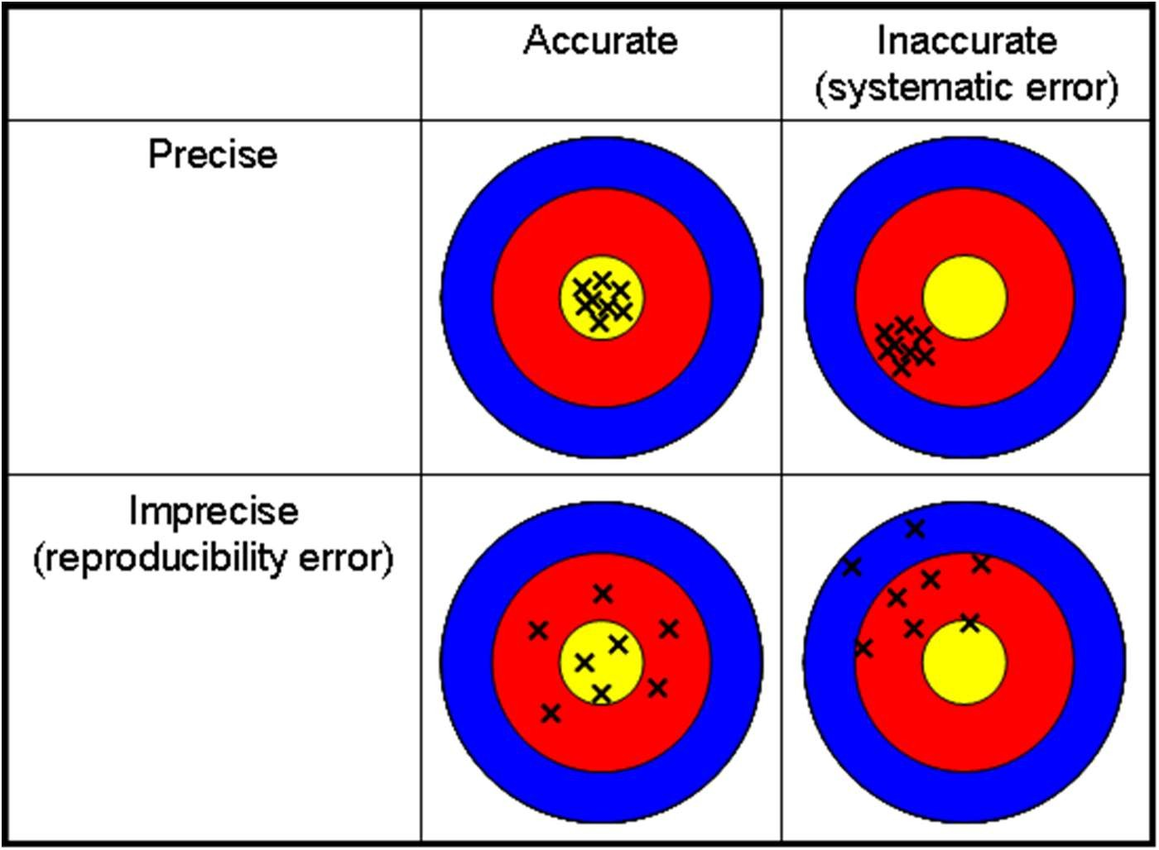
Precision vs. Accuary
Peter A. Steenkiste, CMU
7
https://www.sophia.org/tutorials/accuracy-and-precision--3
Page 7

Slide 8
Approaches
Proximity: estimate distance between two nodes
Trilateration and triangulation
» using elementary trigonometric properties: a triangle is completely determined,
if two angles and a side length are known
if the lengths of all three sides are known
» infer a 3d position from information about two triangles
Fingerprinting (scene analysis)
» using radio characteristics as fingerprint to identify it
Hybrid methods: multiple sources of information
Peter A. Steenkiste, CMU
8
Page 8

Slide 9
Proximity and Distance
Binary nearness: using finite range of wireless communication and/or threshold
» within range of a beacon signal from a source with known position
» yields region locations, e.g.: cell in cellular network
Distance measurement (ranging)
» Received signal strength
» Time of flight (time of arrival)
» Time difference of arrival
Peter A. Steenkiste, CMU
9
Page 9

Slide 10







Measuring Location: Trigonometry Basics
Triangles in a plane
» Lateration: distance measurement to known reference points
a triangle is fully determined by the length of its sides
Time of Flight (e.g. GPS, Active Bat)
Attenuation (e.g. RSSI)
» Angulation: measuring the angle with respect to two known reference points and a reference direction or a third point
a triangle is fully determined by two angles and one side as shown
Phased antenna arrays
aircraft navigation (VOR)
Peter A. Steenkiste, CMU
10
Page 10

Slide 11
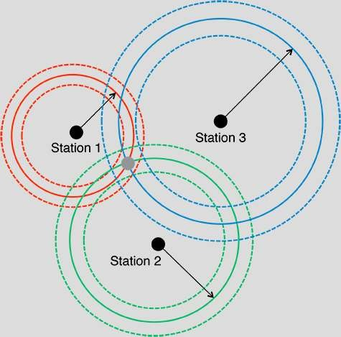
Trilateration
Peter A. Steenkiste, CMU
11
http://gpsworld.com/innovation-where-are-we/
Page 11

Slide 12
Mathematical Background
Computing positions between three known positions (x_{i}, y_{i}) and an unknown position (x_{u}, y_{u}) given distances r_{i} btw (x_{i}, y_{i}) and (x_{u}, y_{u})
Yields three equations (x_{i}-x_{u})² + (y_{i}-y_{u})² = r_{i}²
Linear equations by subtracting 3rd from 1st and 2nd: quadratic terms x_{u}² and y_{u}² disappear
» 2(x₃ – x₁)x_{u} + 2(y₃ – y₁)y_{u} = (r ² – r ²) - (x ² – x ²) - (y ² – y ²)
1 3 1 3 1 3
» 2(x₃ – x₂)x_{u} + 2(y₃ – y₂)y_{u} = (r ² – r ²) - (x ² – x ²) - (y ² – y ²)
2 3 2 3 2 3
In 3D: yields two points
Positioning with imprecise information:
» Add redundancy: over determined solution
» Least squares estimates
Peter A. Steenkiste, CMU
13

Slide 13
GPS
Radio-based navigation system developed by DoD
» Initial operation in 1993
» Fully operational in 1995
System is called NAVSTAR
» NAVigation with Satellite Timing And Ranging
» Referred to as GPS
» Has been improved over time
Series of 24 (now 32) satellites, in 6 orbital planes
Works anywhere in the world, 24 hours a day, in all weather conditions and provides:
» Location or positional fix
» Velocity, direction of travel
» Accurate time
www.fws.gov/southeast/gis/training_2k5/GPS_overview_APR_04.ppt ₁₄
Peter A. Steenkiste, CMU

Slide 14
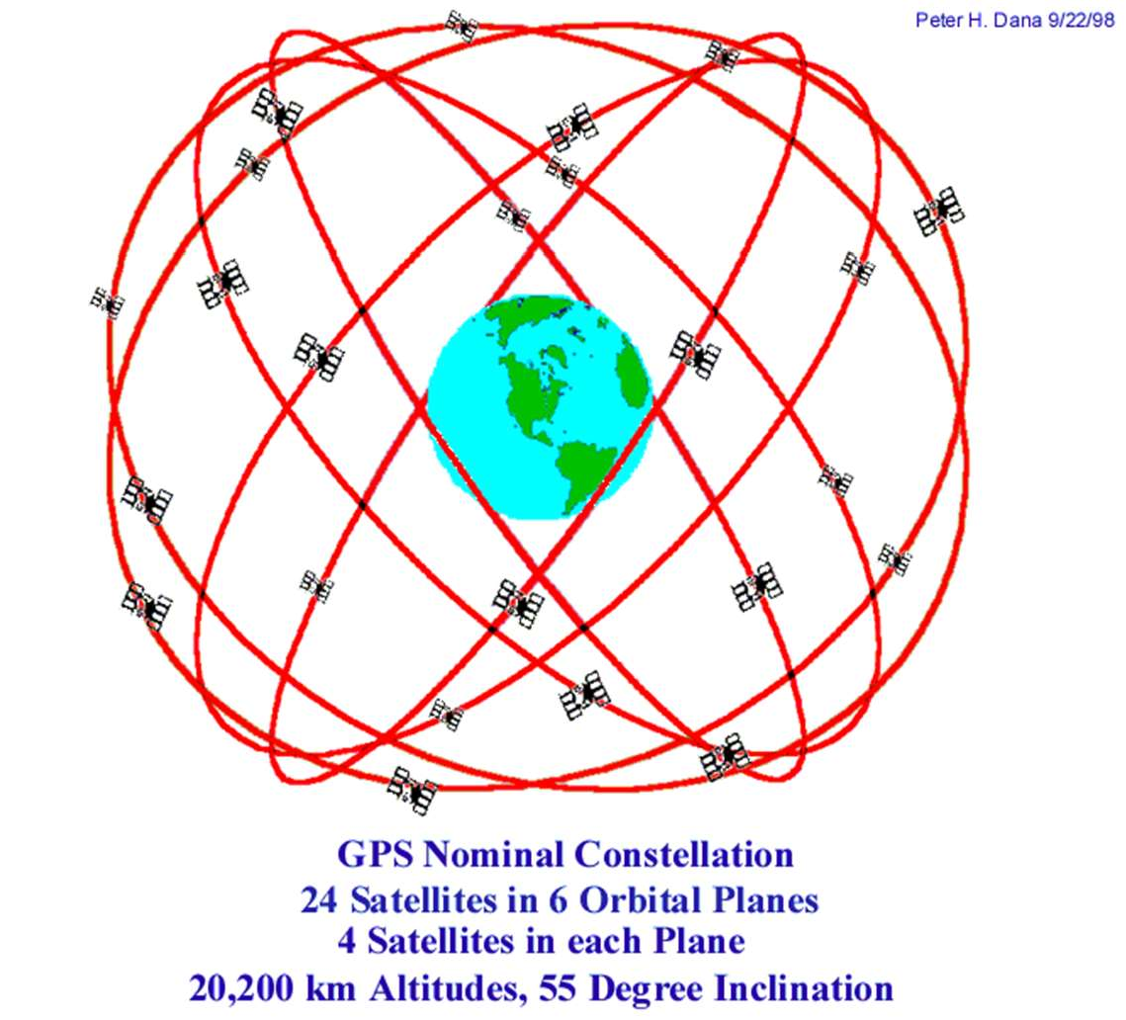
GPS Constellation
24 satellites are needed to guarantee that 4 are always visible everywhere
Extra satellites provide redundancy
» Deal with maintenance, replacement, …
Peter A. Steenkiste, CMU
https://www.colorado.edu/geography/gcraft/notes/gps/gps_f.html
15

Slide 15
GPS involves 5 Basic Steps
Satellite Ranging
» Determining distance from satellite
Trilateration
» Intersection of spheres
Timing
» Why consistent, accurate clocks are required
Positioning
» Knowing where satellite is in space
Correction of errors
» Correcting for ionospheric and tropospheric delays
Peter A. Steenkiste, CMU
16

Slide 16
How GPS works?
Range from each satellite calculated
range = time delay X speed of light
Technique called trilateration is used to determine your position or “fix”
» Intersection of spheres as described earlier
At least 3 satellites required for 2D fix
However, 4 satellites are used
» The 4th satellite used to calculate drift of clock in GPS receivers relative to that of the satellites
» Yields much better accuracy and provides 3D fix
Peter A. Steenkiste, CMU
17

Slide 17
Satellite Positions
Each satellite has an atomic clock that keeps time very accurately
» Satellites synchronize their clocks
» Also periodically synchronize with the true time maintained on earth
Satellites also know their location very accurately
Peter A. Steenkiste, CMU
18

Slide 18
Determining Range
Each satellite periodically generates a pseudo random code
» Receivers also locally generate the codes in synchronized fashion
Receivers measure Time of Arrival (TOA) of codes
Transmission includes Time of Transmission (TOT) of code and the location of the satellite at that time
» Allows receiver to calculate Time of Flight and distance
Series of ones
Measure time difference between the same part of code
and zeroes repeating every 1023 bits. So Complicated alternation
led
 |  |  |  |  |  |  |  |  |  | of bits that pattern looks random thus cal “pseudorandom code”.
eceiver
 |  |  |  |  |  |  |  |  |  | 19
From satellite
From r
Peter A. Steenkiste, CMU

Slide 19








Three Satellite Ranges Known
22,000 Km radius
20,000 Km radius
Located at one of these 2 points.
However, one point can easily
be eliminated because it is either
not on earth or moving at impossible rate of speed.
Peter A. Steenkiste, CMU
21,000 Km radius
21

Slide 20
Accurate Timing is the Key
Satellites have very accurate atomic clocks
Receivers have less accurate clocks
Measurements made in nanoseconds
» Speed of light (c) ~ 1 ft/nanosecond
1/100th of a second error could introduce error of 1,860 miles
Discrepancy between the satellite clock and the receiver clocks must be resolved
Fourth satellite is used to solve the 4 unknowns (X, Y, Z and receiver clock error)
Peter A. Steenkiste, CMU
22
Page 20

Slide 21
Satellite Positioning
Required in the equation to solve the 4 unknowns is the actual location of the satellite.
» 3 coordinates for location, plus clock drift of receiver relative to the satellite clocks
Satellites are in relatively stable orbits and constantly monitored on the ground
Satellite’s position is broadcast in the “ephemeris” data streamed down to receiver
» Downloading complete set of almanac data requires 12.5 minutes (transmitted at 50 bps)
Peter A. Steenkiste, CMU
23

Slide 22
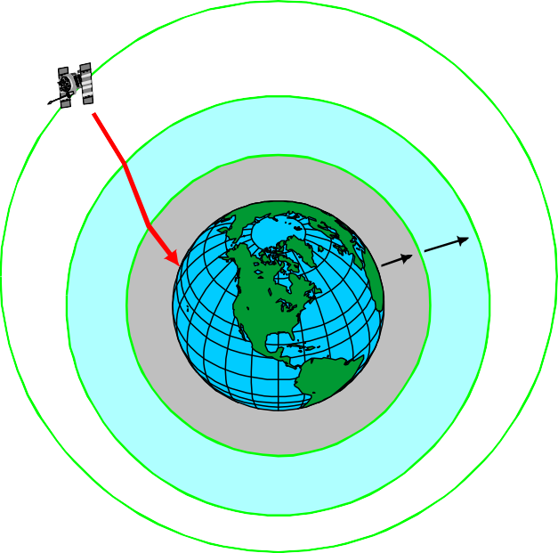
Sources of Errors
Largest source is due to the atmosphere
» Atmospheric refraction
– Charged particles
– Water vapor
Ionosphere (Charged Particles)
Other sources:
» Geometry of satellite positions
» Multi-path errors
» Satellite clock errors
» Satellite position or “ephemeris” errors
» Quality of GPS receiver
Troposphere
Peter A. Steenkiste, CMU
24

Slide 23
How about Indoors?
We can use received WiFI signal strength (RSS) to measure distance to APs with known location!
Does not work in practice: too many factors affects RSS: objects, people, …
» Triangulation based on RSS tends to results tend to give large, unpredictable errors
How about using time of arrival?
» E.g., based on sound, radar-like techniques, …
» Works better, but it is still hard
» Can work well but often requires special infrastructure
» Reflections can also create inaccuracies: longer path!
Peter A. Steenkiste, CMU
25

Slide 24
CAESAR: Carrier Sense-based Ranging
Question: can we use time of flight ranging using commodity WiFi hardware?
Yes, but it gets a bit messy
» Need to include SNR measurement
Local station determines location of (mobile) remote stations
Design criteria
» Exploit standard 802.11 protocol implementations
» Real time results
» Low cost (low network usage, no additional hardware, minimal calibration)
Peter A. Steenkiste, CMU
26

Slide 25
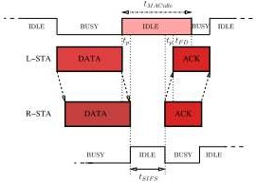
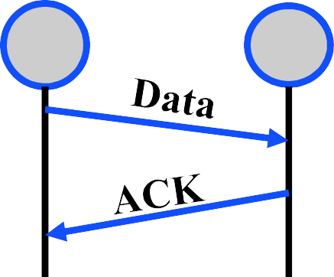
CAESAR: Key Idea Time of flight from ACKs Speed of light: c = ~300m/s WLAN clock 44MHz ➢ Resolution: 300/(2*44) = 3.4m Distance d = c*(t_{MacIdle}-t_{SIFS}-t_{FD})/2 1 2
Distance = ½ time from end of data to beginning of ACK
Peter A. Steenkiste, CMU 27

Slide 26
CAESAR: Adjustment to Noise
Method depends on correct estimation of response time, which depends on the SNR
Automatic gain control is used if
» Preferred region (PR): no AGC
» Strong signal detected (SSD): e.g. subtract 30dB from from signal
» Weak signal detected (WSD): may need adjust signal to to bring it into PR (or signal is not detected)
Proposed solution:
» Detect states SSD, WSD, and preferred range
» Use different values for Time for Frame Detection ( t_{FD})
Peter A. Steenkiste, CMU
28

Slide 27
Outline
Properties of localization procedures
Approaches
» Proximity
» Trilateration and triangulation (GPS)
» Finger printing (RADAR)
» Hybrid systems
Peter A. Steenkiste, CMU
29

Slide 28
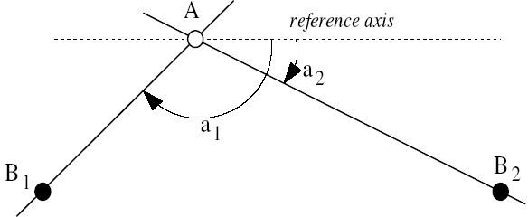
Angle of Arrival (AoA)
A measures the direction of the incoming signal using a radio array.
By using 2 anchors, A can determine its position
Alternatively: the anchor measure the angle of A’s signal and coordinate
Peter A. Steenkiste, CMU
30

Slide 29
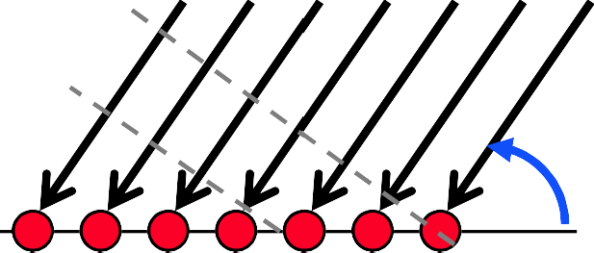
Angle of Arrival Techniques
Antenna arrays are increasingly popular
They are usually used to steer the signal, but can be used to identify the angle at which it arrives
Difference in arrival time can be used to measure angle
t₁
t₂
Peter A. Steenkiste, CMU
31

Slide 30
Outline
Properties of localization procedures
Approaches
» Proximity
» Trilateration and triangulation (GPS)
» Finger printing (RADAR)
» Hybrid systems
Peter A. Steenkiste, CMU
32
Page 30

Slide 31
Location Fingerprinting
Fingerprint Methods for Recognizing Locations
» Examples
Visual identification of places from photos
Recognition of horizon shapes
Measurement of signal strengths of nearby networks (e.g. RADAR)
» Method: computing the difference between a feature set extracted measurements with a feature database
» Advantages: passive observation only (protect privacy, prevent communication overhead)
» Disadvantage: access to feature database needed
Peter A. Steenkiste, CMU
33

Slide 32
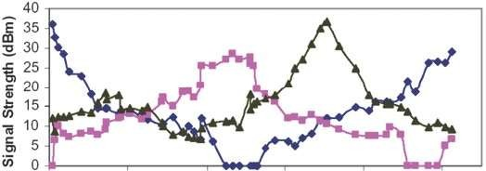
RADAR: Key Idea
RSS from multiple APs tends to be unique to a location
AP1
AP2 AP3
0
20
40
60
80
100
Distance along walk (meters)
Peter A. Steenkiste, CMU
34

Slide 33
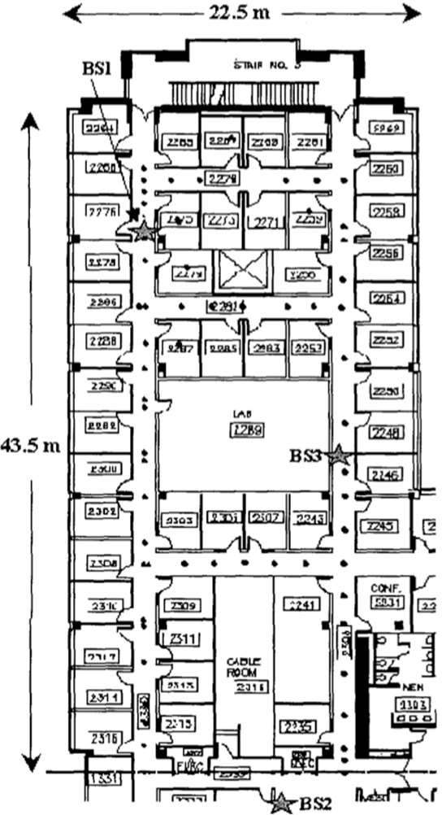
RADAR Approach
Scenario: floor layout with three base stations (in the hallways)
Empirical method
» offline phase: database is constructed
collect signal strength measurements from all three base stations at 70 distinct locations
store each of the 70 measurement triples together with the spatial location and orientation in a database
» online phase: position can be determined
measure the current signal strength from all three base stations
find the most similar triple(s) in the database
» Resolution 2.94m (50th percentile)
Peter A. Steenkiste, CMU
- Base Station
35

Slide 34
Model-Based Radio Map
Model set-up phase has high cost
Alternative use radio propagation model and floor plan (instead of measurements)
» Considered models
Rayleigh fading model: small-scale rapid amplitude fluctuation to model multi-path fading
Rician distribution model: like Rayleigh but with additional LoS component
Floor Attenuation Factor propagation model: large scale path loss with building models
Wall Attenuation Factor model: considers effects from walls between transmitter and receiver
» Resolution 4.3m (50th percentile)
Peter A. Steenkiste, CMU
36

Slide 35
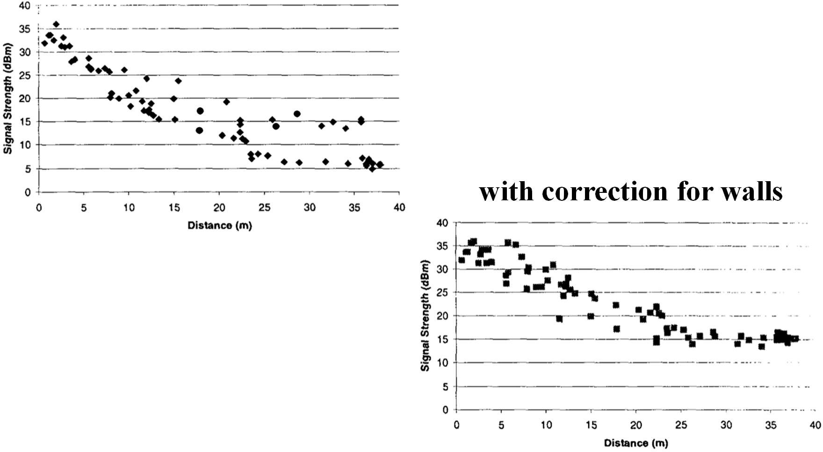
Effects of applying correction
signal strength as a function of distance
with correction for walls
Peter A. Steenkiste, CMU
37

Slide 36
Limits of Localization Using Signal Strength
Measuring distance based on signal strength is an attractive idea for wireless sensor networks:
» RSS does not require additional hardware
» RSS declines with distance
» Many different promising methods proposed
But accuracy is quite limited
» 802.11 technology with a range of methods and environments tested
» Median localization error of 10ft and 97th percentile of 30ft
Many technologies with higher accuracy have been developed
» E.g., UWB, use of AoA, …
Peter A. Steenkiste, CMU
38

Slide 37
Hybrid Technologies
Cell phones: have many other sensors
» Accelerometer, compass, …
Can be used to estimate the user’s walking speed, direction, …
This information can be combined with finger printing based techniques
Especially useful if finger printing provides accurate location in specific points
» When entering a store, escalator, elevators
» Can use the other sensors starting with these well- knownlocations
Peter A. Steenkiste, CMU
39

Slide 38
Literature
H. Karl and A. Willig (2005). Protocols and Architectures for Wireless Sensor Networks, Ch. 9 Localization and positioning. John Wiley & Sons.
P. Bahl and V. N. Padmanabhan (2000). RADAR: An In- Building RF-based User Location and Tracking System. IEEE INFOCOM 2000, pp. 775-784.
E. Elnahrawy et al. (2004). The limits of localization using signal strength: a comparative study. IEEE SECON 2004, pp. 406-414 .
D. Giustiniano, and S. Mangold (2011). CAESAR: Carrier Sense-Based Ranging in Off-The-Shelf 802.11 Wireless LAN. ACM CoNEXT 2011.
Peter A. Steenkiste, CMU
40

